Slide 1




Township of Essa
New Official Plan
Statutory Public Meeting
April 15th, 2026

Slide 2
Introductions
Samuel Haniff, RPP, MCIP
Manager of Planning
Township of Essa
Tim Cane,
RPP, MCIP
Project Lead
SGL Planning & Design Inc.
Zahra Jaffer,
RPP, MCIP
Engagement Lead
Dillon Consulting Limited

Slide 3

What is the Official Plan?
What will Essa look like in 2051?
What policies on how land is developed and where we grow do we need to get there?
The Official Plan must be consistent and conform to:
Provincial policy and legislation:
The Planning Act
The Provincial Planning Statement (PPS)
Any other applicable provincial plans
County of Simcoe Official Plan

Slide 4
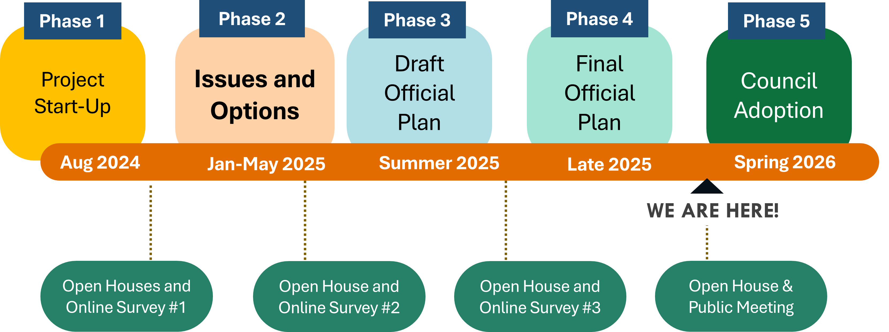
Schedule & Community Engagement

Slide 5

What We Have Heard
Protect nature
Balance residential and commercial growth with agricultural land needs
Maintain rural character
Support more walking and cycling
Build connected, sustainable & resilient communities
Attract diverse food & retail services

Slide 6
Statutory Open House
Held on April 8th, 2026 at the Thornton Community Centre, from 5:00pm – 7:00pm.
Approximately 30 participants.
Shared the Draft 2 Official Plan policies and maps (schedules) and discussed key changes from Draft 1.
Received feedback on the policy directions and on some site-specific considerations.

Slide 7
Planning for Growth
Growth Projections
 | County of Simcoe* |  | Township of Essa
 | Forecast to 2051 | Increase from 2021 | Forecast to 2051 | Increase from 2021
Population | 555,020 | 194,340 | 34,740 | 10,930**
Jobs | 197,980 | 81,380 | 13,350 | 3,720
*approved Simcoe County Amendment No. 7 (SCOPA7) asof April 7, 2026
**Equates to approx. 135 ha (340 acres net) of additional lands
Note: Additional growth possible through Provincial South Simcoe Growth Strategy.

Slide 8
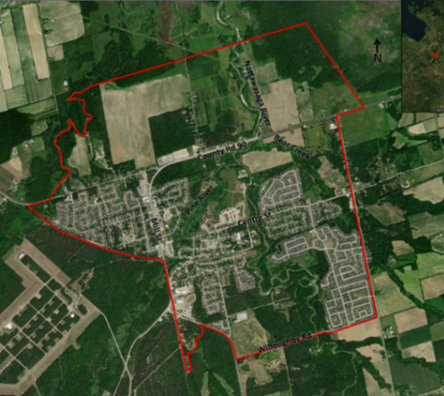
Settlement Area Boundary Expansion
Based on land needs completed by the County of Simcoe (135 ha)
Requests received were reviewed and compiled
Boundary adjustments will be considered using criteria identified in Background Report May 2025 and new official plan
Requests will be considered further with other growth processes and with specific amendments to the new Official Plan in future.

Slide 9
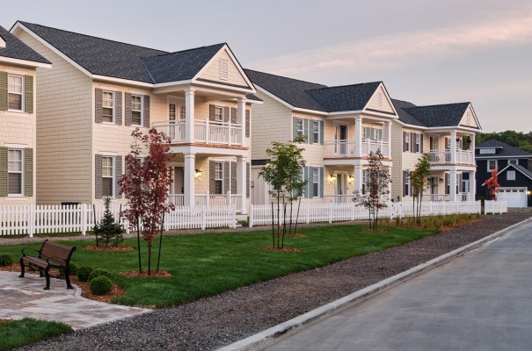
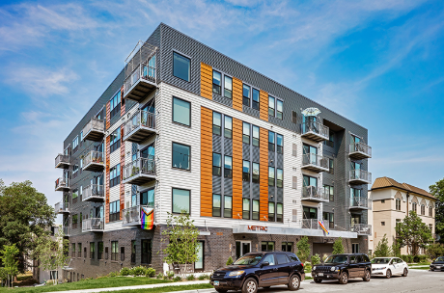
Draft Policy Directions
Housing and Residential
Range of housing types and supporting uses (e.g. small shops, schools)
Density increases with policies to help maintain character
Age-friendly, barrier free and accessible housing options.
Innovative housing forms including co-housing, modular or prefabricated housing, tiny homes.
5% of units in all new housing development is required to be affordable, to support Simcoe County’s overall target of 10% affordable housing stock.

Slide 10
Draft Policy Directions
Housing and Residential
Partnerships with housing providers and upper-tier agencies.
Residential Low designation: Permits single detached, semi-detached, duplex and townhouses up to 3 storeys.
Home occupations may be allowed if located within the primary residence or accessory buildings (e.g. garage).
Residential Multiple designation permits a range of multi-unit residential building types (e.g. townhouses, apartments, etc.) up to between 6 and 8 storeys
Accessory Dwelling Units (up to 2) in all areas.
What’s New?
Key Changes from Draft 1:
More clarity for preferred areas of growth – Angus and Baxter.
Reference to future growth process.
Increase in intensification/infill target from 20 to 30%.
Flood hazard policies.
New employment land area near Barrie.
Continued requirement for 5% affordable housing.

Slide 11
Draft Policy Directions
Employment & Commercial
Commercial designation: Allow a range of shopping, offices, businesses
Buildings of up to 2 storeys in height will be permitted.
Mixed-Use designation: Expanded to a wider area in Angus and Thornton to allow buildings with commercial and residential uses.
Employment designation: Permit range of industry and large employment uses
Employment uses in three main areas: Existing areas in Baxter and on County Road 56, and a new area on County Road 27.
What’s New?
Key Changes from Draft 1:
More flexibility for integration between residential and live/work or commercial units.
Potential for development in Baxter will be dependent on future infrastructure.
Permitted uses for Employment widened.
Research and development must be in connection with manufacturing.
New employment area proposed.

Slide 12
Draft Policy Directions
Agricultural
Protect farms for the long term, exclude non-agricultural uses.
Minimum lot size of 40 hectares, restricting severances.
Encourage different farm types and sizes with wider range of farm-related activities (i.e. tourism, farm diversified uses, home occupations, small scale home industries)
Minimize impacts from surrounding development.
Short Term Accommodation policies.
Agri-food uses encouraged.
What’s New?
Key Changes from Draft 1:
Importance of Essa Agriplex highlighted.
Stricter lot creation policies.
More support for agri-tourism policies.
Guidance for non-agricultural uses.

Slide 13
Draft Policy Directions
Rural
What’s New?
Key Changes from Draft 1:
Recognize role in supporting farms, prioritize and protect agricultural uses.
Respect rural character.
Lot creation with adequate servicing.
Non-agricultural uses would only be permitted with Council approval.
Guidance for non-agricultural uses.
Policies for new multiple lots (up to 3 new lots) added.
Clarification added relating to no new estate residential developments.
Reference to natural hazards added relating to where development is permitted.

Slide 14
Draft Policy Directions
Natural Heritage
What’s New?
Key Changes from Draft 1:
Protect, maintain, and enhance water resources and natural areas.
Provide buffers around natural features.
Require an Environment Impact Study for new development near environmental features (per Provincial regulations).
Support partnerships with local organizations.
Greater clarity on what can be considered a natural feature.
Introduction of natural heritage and hazard mapping.
Source Water Protection policies and maps added.
No new development or lots on hazard lands will be permitted, unless with an approved study.

Slide 15
Draft Policy Directions
Community Design
What’s New?
Key Changes from Draft 1:
High quality design of spaces and places that reflect Essa’s rural and small-town character.
Accessible, age-friendly and barrier free spaces.
Plan for more passive recreational areas, like picnic and play areas, trails, and seating areas.
Libraries are a key community anchor.
Protect and preserve cultural heritage.
Schools and child care permitted in all designations.
Recognized role of community hubs and combined community services.
Library floor space target added.
Parkland dedication criteria added.

Slide 16
Draft Policy Directions
Sustainability
Adapt to extreme weather.
Support energy efficiency and conservation.
More sustainable and resilient new development.
New schools to walk to and connect neighbourhoods.
Connected public spaces.
Encourage food access – community gardens, farmers’ markets, green roofs, etc.
Promote education and collaboration.
What’s New?
Key Changes from Draft 1:
Broader support for food retailers.
Wider permissions for urban agriculture e.g. on vacant/underutilized lands, commercial and institutional sites.

Slide 17
Draft Policy Directions
Transportation
Coordinate with Simcoe County LINX Transit to connect places within Essa and to neighbouring municipalities.
Support transit and cycling infrastructure for new/upgraded streets.
Protect lands around the railway corridor to allow for future rail service.
Plan for improved transit connectivity particularly between key settlement areas like Angus, Thornton and Baxter.
What’s New?
Key Changes from Draft 1:
Guidelines for development near railways.
Clarification for entrance permits.

Slide 18
Draft Policy Directions
Infrastructure
Water and sewage services to support growth and be financially responsible
Only grow where there is existing or planned (EA) servicing
Protect and conserve existing water resources
Integrate sustainable stormwater management, green infrastructure
What’s New?
Key Changes from Draft 1:
Servicing policies expanded to all of Essa, not just Angus.

Slide 19

Next Steps
Consider all comments (receive by April 27, if possible)
Final New Official Plan presented to Council for Approval: May 6 2026
Stay involved and connected!
essatownship.on.ca/official-plan-review/
Samuel Haniff Tim Cane
Manager of Planning Project Manager
Township of Essa SGL Planning and Design
705-424-9917 x111 705-796-7069
shaniff@essatownship.on.ca tcane@sglplanning.ca

