Slide 1


Township of Essa
New Official Plan
WELCOME!
Join us for a conversation about the future and how we plan for our communities to grow and thrive
Wednesday April 8th
5:00-7:00pm
Thornton Community Centre, Essa
Notes:
What is the project

Slide 2
Township of Essa
New Official Plan
What is an
Official Plan?
A key document that lays out where and how we plan to grow into the future, and guides where we live, work, and play.
What is the Township doing?
DEVELOPING A NEW OFFICIAL PLAN!!
The project to update policies and develop a new Official Plan was started in 2020 and is ongoing
Why are we
doing this?
The Township is required to develop policies to guide growth to 2051 and bring our Official Plan into conformity with the latest Provincial guidance.
Let’s talk about the next 25 years
The Township is projected to grow more than 30% by 2051, adding close to 11,000 new residents and over 3,700 new jobs. Let’s talk about how and where we plan to grow!
Your input will help shape the directions and policies for the New Official Plan.
Notes:
What is the project

Slide 3





Five Key Themes for the New Official Plan
Rural Essa –
Farmland
Planning for the protection of farmland and growth of the agri-food industry in Essa
Natural Essa –
Protecting the Environment
Protecting nature and directing development away from sensitive environmental areas
Growing Essa –
Housing and Jobs
Providing support for a range of housing types and more opportunities for business and job growth
Resilient Essa –
Services and places and spaces to play and gather
Planning for healthy, walkable communities, with a range of parks and open spaces, libraries, and recreational areas.
Connecting Essa –
How we move through the community
Designing for streets to support different ways to travel through the community including by car, bus, walking, or rolling

Slide 4
Project Process and Key Steps
There are five main phases to the project, with community engagement and gathering of input planned at key milestones.
Phase 1
Phase 2
Phase 3
Phase 4
Phase 5
Project Start-Up
Issues and Options
Draft Official Plan
Final Official Plan
Council Adoption
Aug 2024
Jan-May 2025
Summer 2025
Late 2025
Spring 2026
WE ARE HERE!
Open Houses and Online Survey #1
Open House and Online Survey #2
Open House and Online Survey #3
Open House & Public Meeting
Exploring the Issues and Options
A Background Research report has been prepared to explore the key topics for the New Official Plan, and develop recommendations for two main topics:
Settlement Area Boundary Expansions
Key Policy Directions
We are undertaking a technical review to determine how and where to expand the Essa growth boundary to accommodate the need for new community areas. The amount of land needed is guided by the Simcoe County Official Plan and Municipal Comprehensive Review (2023).
New expansion areas would be on lands within Essa that can accommodate more growth. The final confirmation of Settlement Area Boundary Expansions will be part of future work through amendments to the Official Plan.
The New Official Plan includes updated policies to align with the latest Provincial guidance, and integrates policies from the Simcoe County Official Plan.
There are several key policy areas in the New Official Plan, including housing, employment, agricultural areas, rural areas, community design, natural heritage, sustainability, transportation, and infrastructure. The policies have been developed based on the background studies completed from 2024- 2025.

Slide 5
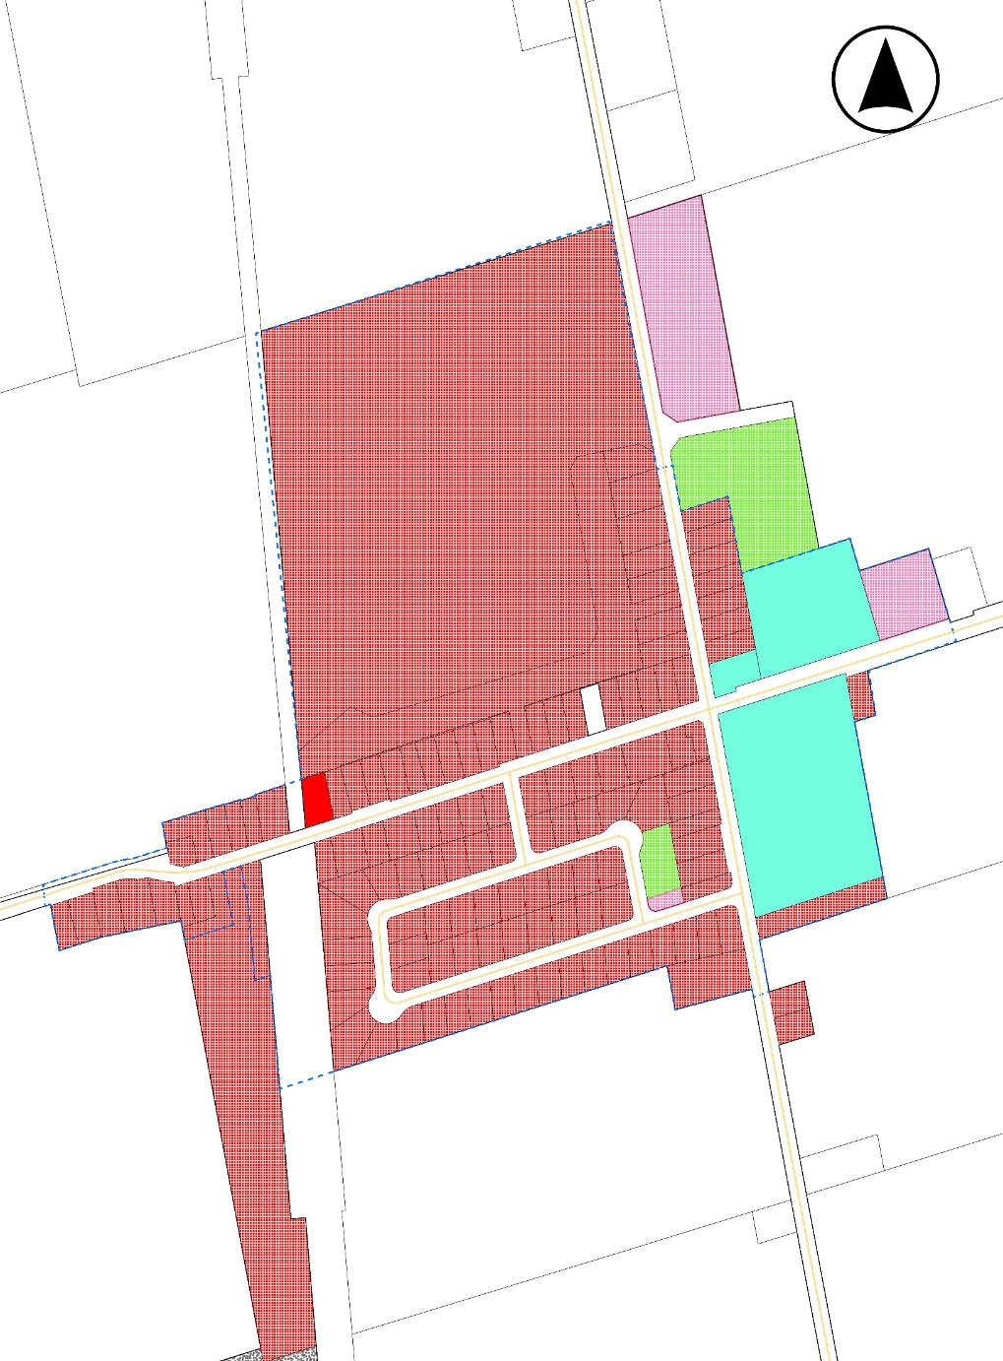
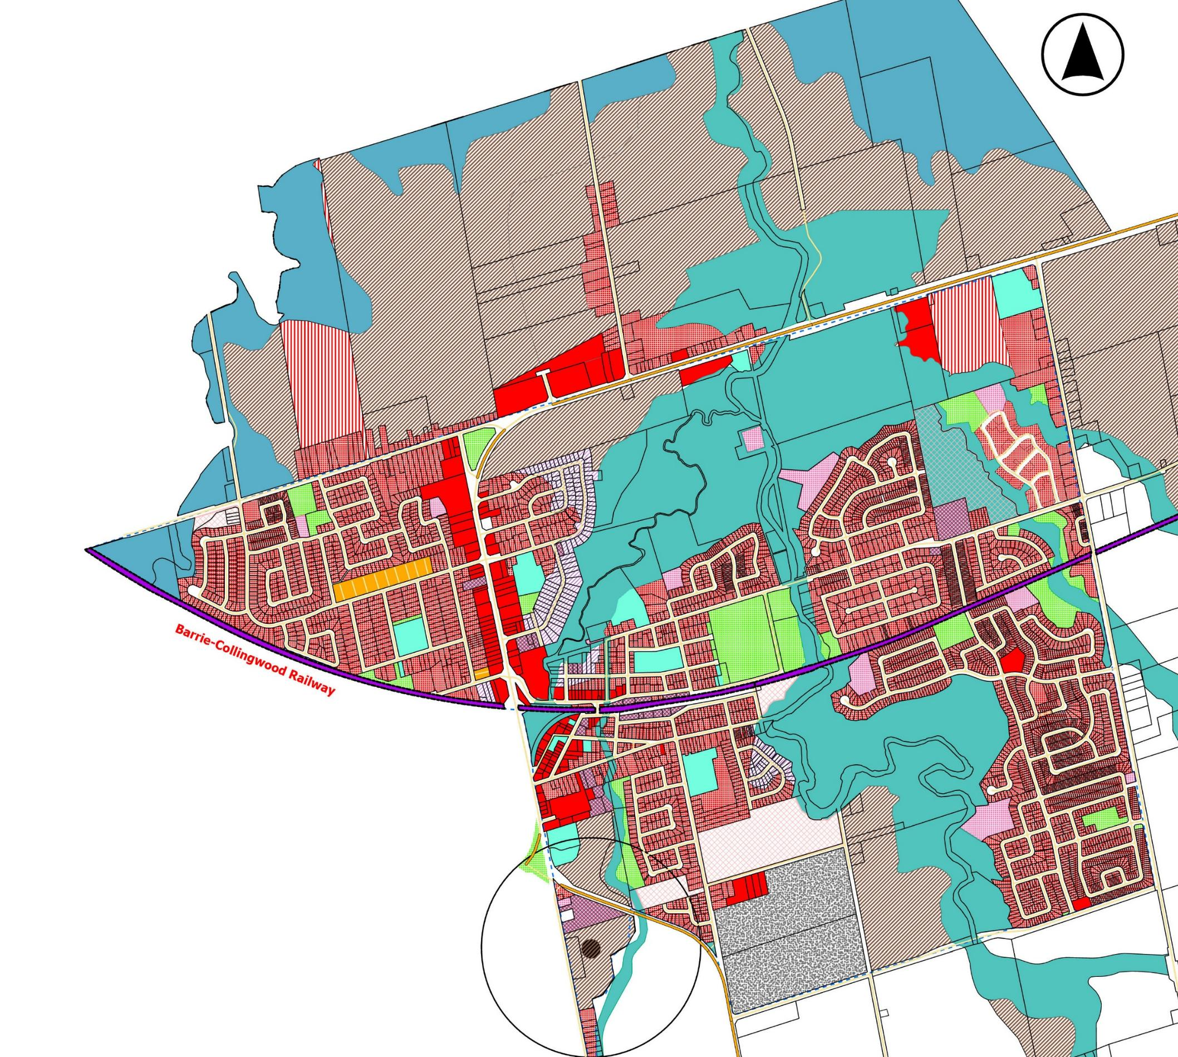
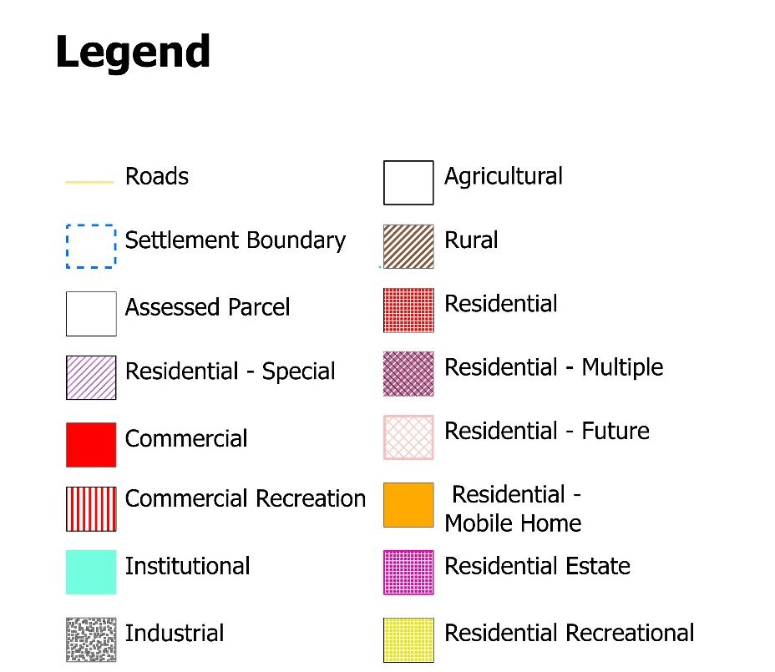
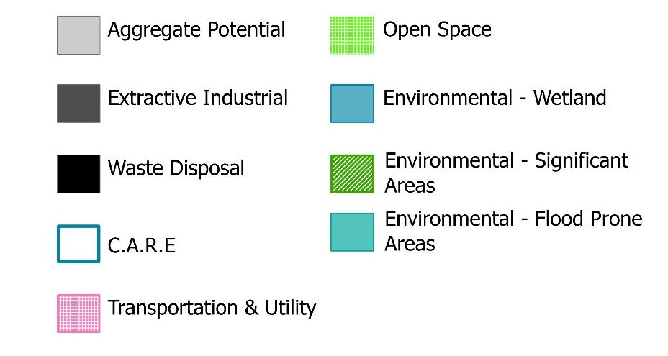
Settlement Area Boundary Expansions
Where could we grow?
There are two main areas in Essa where lands could be brought into the Settlement Area Boundary to allow for future growth:
Connecting to Angus
Connecting to both Angus and Baxter (dependent on infrastructure servicing)
How do we make a decision?
To decide where new areas for growth will be allocated, we will evaluate potential lands based on several considerations, including:
The lands should be adjacent to Angus, Essa’s principal settlement area.
There is an opportunity for more density and complete communities on the expansion area lands.
There is an opportunity for a range of housing types on the expansion area lands.
The expansion area can be grown while allowing for rural areas in Essa to remain protected.
There are no significant impacts on agricultural operations if the expansion areas are developed for growth.
The impacts to natural heritage and water resources have been considered and can be reduced or managed.
The growth aligns with sustainability and climate resiliency priorities for the Official Plan.
The final confirmation of Settlement Area Boundary Expansions will be part of future work through amendments to the Official Plan.
Baxter
Angus

Slide 6

Key Policy Directions
Housing and Residential
Range of housing types and supporting uses (e.g. small shops, schools).
Density increases with policies to help maintain character.
Age-friendly, barrier free and accessible housing options.
Innovative housing forms including co-housing, modular or prefabricated housing, tiny homes.
5% of units in all new housing development is required to be affordable, to support Simcoe County’s overall target of 10% affordable housing stock.
Partnerships with housing providers and upper-tier agencies.
Residential Low designation: Permits single detached, semi-detached, duplex and townhouses up to 3 storeys.
Home occupations may be allowed if located within the primary residence or accessory buildings (e.g. garage).
Residential Multiple designation permits a range of multi-unit residential building types (e.g. townhouses, apartments, etc.) up to between 6 and 8 storeys.
Accessory Dwelling Units (up to 2) in all areas.
What’s New?
Key changes from Draft #1
More clarity for preferred areas of growth – Angus and Baxter.
Reference to future growth process.
Increase in intensification/infill target from 20 to 30%.
Flood hazard policies.
New employment land area near Barrie.
Continued requirement for 5% affordable housing.
What else should we consider? Add a sticky note with your comments.

Slide 7

Key Policy Directions
Employment and Commercial
Commercial designation: Allow a range of shopping, offices, businesses.
Buildings of up to 2 storeys in height will be permitted.
Mixed-Use designation: Expanded to a wider area in Angus and Thornton to allow buildings with commercial and residential uses.
Employment designation: Permit range of industry and large employment uses.
Employment uses in three main areas: Existing areas in Baxter and on County Road 56, and a new area on County Road 27.
What’s New?
Key changes from Draft #1
What else should we consider? Add a sticky note with your comments.
More flexibility for integration between residential and live/work or commercial units.
Potential for development in Baxter will be dependent on future infrastructure.
Permitted uses for Employment widened.
Research and development must be in connection with manufacturing.
New employment area proposed.

Slide 8

Key Policy Directions
Agricultural Areas
The Agricultural designation is intended to preserve the agricultural community by excluding non-agricultural or incompatible uses.
Generally, the minimum lot size for an agricultural use shall be approximately 40 hectares. Exceptions to this will require supporting studies.
Home occupations and small-scale home industries as defined within the Official Plan may be permitted as on-farm diversified uses.
Short Term Accommodation may be permitted as on-farm diversified uses, and shall be regulated by the Township’s Zoning By-law and licensing.
Short Term Accommodation will need to be located within a single detached dwelling.
Agri-food uses are encouraged on Agricultural lands to promote the local food economy, e.g. short term accommodation, educational experiences; seasonal and visitor-oriented events, festivals, and farm employee accommodations.
What’s New?
Key changes from Draft #1
Importance of Essa Agriplex highlighted.
Stricter lot creation policies.
More support for agri-tourism policies.
Guidance for non-agricultural uses.
What else should we consider? Add a sticky note with your comments.

Slide 9
Key Policy Directions
Rural Areas
The Rural designation will allow a uses that retain the natural landscape and rural character of these areas.
Agricultural uses which exist in the Rural designation shall be prioritized and protected, to maintain their function.
Non-agricultural uses would only be permitted with Council approval.
Lot creation will be permitted only with adequate servicing.
What’s New?
Key changes from Draft #1
What else should we consider? Add a sticky note with your comments.
Guidance for non-agricultural uses.
Policies for new multiple lots (up to 3 new lots) added.
Clarification added relating to no new estate residential developments.
Reference to natural hazards added relating to where development is permitted.

Slide 10

Key Policy Directions
Natural Heritage and Water
The Official Plan places a priority on protecting natural heritage areas, with development buffers providing some distance from wetlands, woodlands, valley land, wildlife habitat, fish habitat, flood prone areas, and other designated natural features.
As per Provincial requirements, an Environmental Impact Study will be required where development is proposed nearby to environmental features.
The Greenlands designation is intended to support preservation and conservation, forestry, erosion works, passive recreational uses, existing agricultural uses, and mineral aggregate operations where approved in the Official Plan.
What’s New?
Key changes from Draft #1
What else should we consider? Add a sticky note with your comments.
Greater clarity on what can be considered a natural feature.
Introduction of natural heritage and hazard mapping.
Source Water Protection policies and maps added.
No new development or lots on hazard lands will be permitted, unless with an approved study.

Slide 11
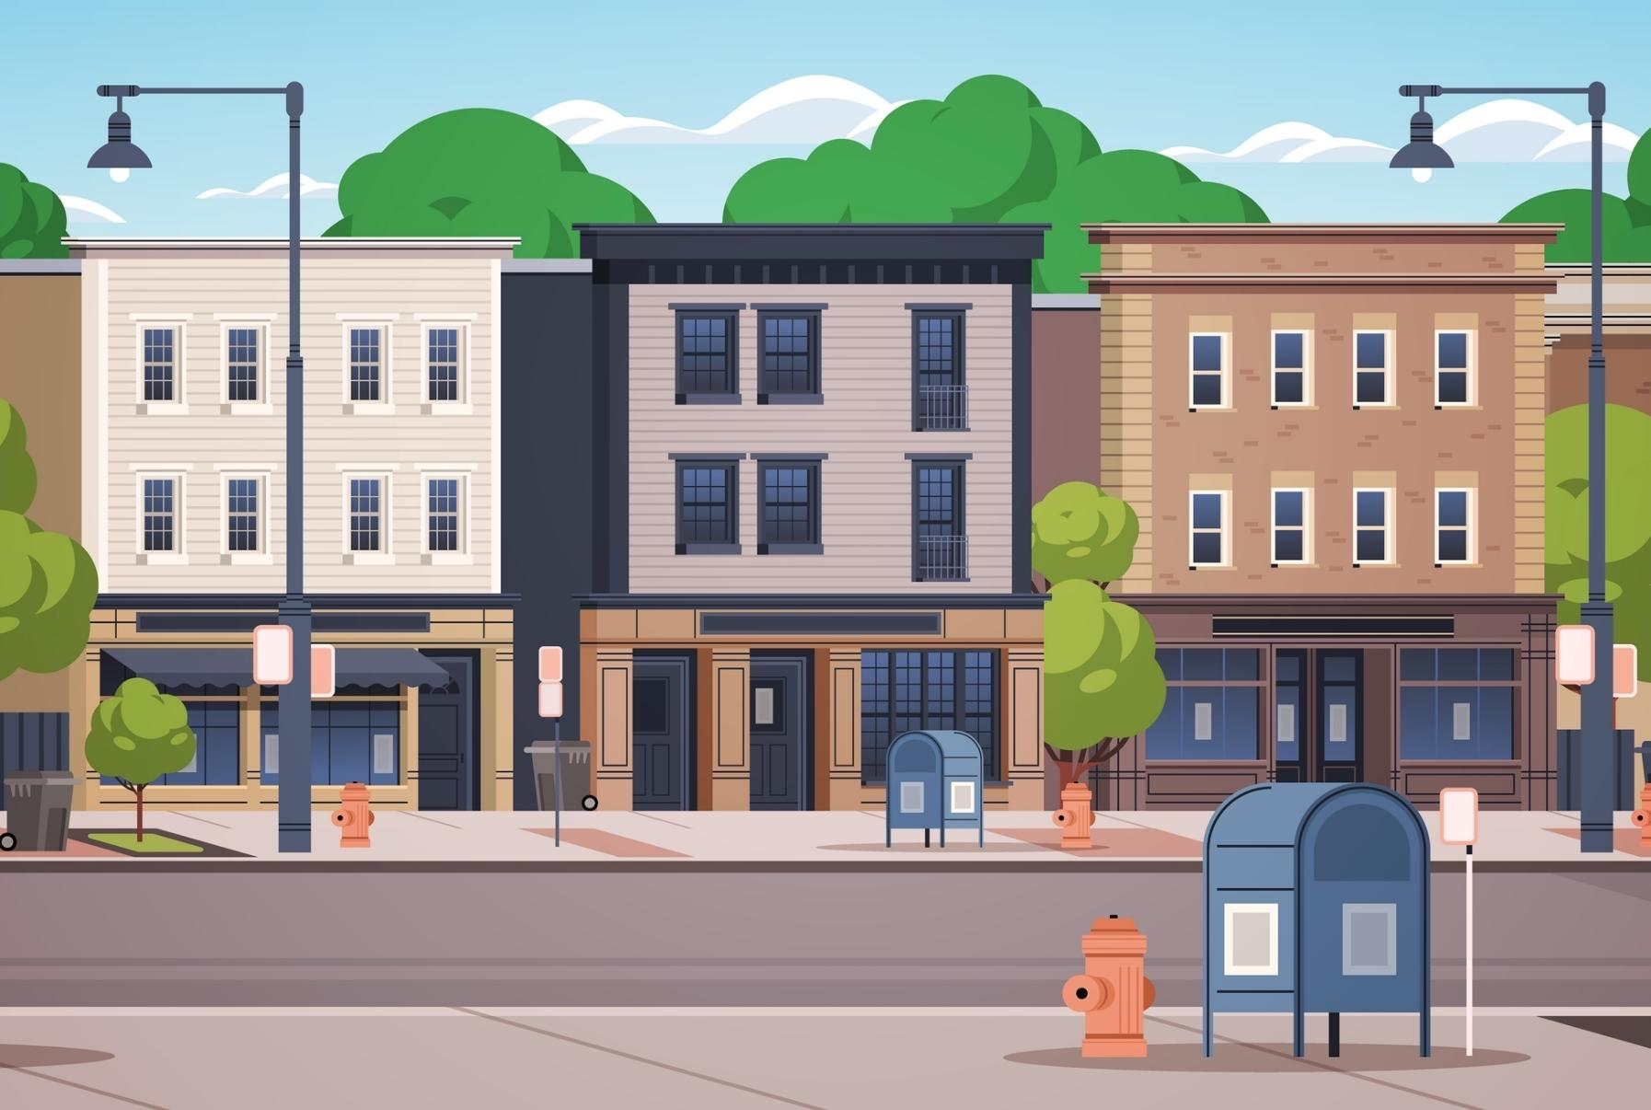
Key Policy Directions
Community Design and Sustainability
Apply high quality urban design, and create spaces and places that are inclusive and preserve Essa’s rural and small-town character.
Use a range of tools to support active, interesting and inviting spaces including public art, paving, signage, street furniture, and landscaping.
Design public spaces to be accessible, age-friendly and barrier free.
Consider community safety, diversity, and comfort in the design of public spaces.
Libraries are a key community anchor, encourage their use and design them to be inclusive, safe, and welcoming.
Cultural heritage is an important element of Essa’s history, support heritage preservation and enhancement.
Connect planning of public spaces with pedestrian and cycling infrastructure including pathways, trails, hydro and gas corridors, and any other cycling routes.
Encourage community gardens, farmers’ markets, community kitchens, food co-ops, and green roofs.
Design compact mixed-use communities, reduce the need for car travel, encourage energy efficient building design, manage stormwater, protect and grow the tree canopy.
Promote education and collaboration on sustainability and climate action.
What’s New?
Key changes from Draft #1
Schools and child care permitted in all designations.
Recognized role of community hubs and combined community services.
Library floor space target added.
Parkland dedication criteria added.
Broader support for food retailers.
Wider permissions for urban agriculture e.g. on vacant/underutilized lands, commercial and institutional sites.
What else should we consider? Add a sticky note with your comments.

Slide 12

Key Policy Directions
Transportation and Infrastructure
Coordinate with Simcoe County LINX Transit towards service growth within Essa and between/among neighbouring municipalities.
Support transit and cycling infrastructure through complete street design for new/upgraded streets.
Support cycling and walking between neighbourhoods, transit stations, employment and retail areas, tourism destinations, community services, and County connections.
Protect lands around the railway corridor to allow for future expansion for freight or passenger rail service.
Plan for improved transit connectivity particularly between key settlement areas like Angus, Thornton and Baxter.
Protect and conserve water resources and water quality.
Plan for any settlement area boundary expansions only to areas with existing or planned servicing.
Integrate sustainable stormwater management into new development to reduce the impact of flooding due to extreme weather.
Plan for green infrastructure that integrates more trees and green spaces into development, streets, and public spaces.
Development in Angus will only proceed where sufficient servicing capacity exists for water and wastewater, or where the Township has approved an agreement for a developer to fund or construct servicing.
What’s New?
Key changes from Draft #1
Guidelines for development near railways.
Clarification for entrance permits.
Servicing policies expanded to all of Essa, not just Angus.
What else should we consider? Add a sticky note with your comments.

Slide 13



Stay in Touch!
    Stay up to date with our progress and attend the Statutory Public Meeting on April 15th, 2026 at the Essa Administration Centre.
    Your input will help shape the final New Official Plan policies and mapping.
    You can also share your comments on Draft 2 of the New Official Plan by email: Officialplan@essatownship.on.ca
Stay involved and connected!
essatownship.on.ca/official-plan-review/
Samuel Haniff Tim Cane
Manager of Planning Project Manager
Township of Essa SGL Planning and Design
705-424-9917 x111 705-796-7069
shaniff@essatownship.on.ca tcane@sglplanning.ca

