Slide 1
Public Meeting: Additional Residential Units April 21, 2021 Presented By: Aimee Powell BURPl., MPA, MCIP, RPP Manager of Planning and Development
(zb2-2021 & opA 38-2021)

Slide 2
Overview
January 2020 – Staff made the request of Council to create a proposed ARU program and the accompanying Official Plan Amendment and Zoning By-law Amendment
January 2020 to February 2021 – Staff drafted Official Plan and Zoning By-law Amendments for Additional Residential Units to receive further input from Council, the Public, Township Departments and applicable agencies/authorities.
March 2021 – Staff requested for Council to authorize Staff to proceed to a Public Meeting to present the Draft Official Plan Amendment and Zoning By-Law Amendment to implement Additional Residential Units

Slide 3
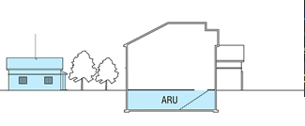
Additional Residential Unit - Timeline
Second ARU
Staff recommendation report to initiate the process to permit Additional Residential Units through a municipally led Official Plan Amendment and Zoning By-law Amendment.
Primary Dwelling
Jan. 2020
Draft Official Plan and Zoning By-law policies based on discussions with Council and comprehensive review of planning policy.
Mar. 2021
Apr. 2021
Public Meeting held to receive further input from Council and the Public on drafted policies.
WE ARE HERE!
Staff to review all comments received through the public consultation process and prepare a recommendation report to introduce the final draft policies.
Jun. 2021
Staff recommendation report presented to Council to adopt Official Plan Amendment and endorse the proposed Zoning By-law Amendment.
If adopted, submit adopted Official Plan Amendment to County of Simcoe for Approval.
Jul. 2021
If Official Plan Amendment is approved by the County of Simcoe, the implementing Zoning By-law will be submitted to Council for final approval.
The Official Plan and Zoning By-law text will be updated to incorporate approved policies.
Fall 2021
Staff to continue to update a list on the approved Additional Residential Units.
On Going

Slide 4
Z2 – 2021 & OPA 38 – 2021 (Additional Residential Units)
Second ARU
Primary Dwelling
Subject Lands:
These Amendments apply to land within the entire geographical area of the Township of Essa
Purpose:
To align the Township of Essa Official Plan policies and Zoning By-law standards with provincial policy regarding Additional Residential Units
The proposed Amendments will permit the use of Additional Residential Units on properties that are zoned to permit single detached, semi-detached or rowhouse dwellings.

Slide 5
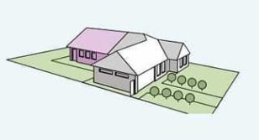
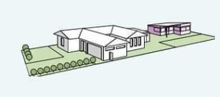
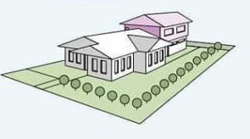
Z2 – 2021 & OPA 38 – 2021 (Additional Residential Units)
Policy Overview
Planning Act
Provincial Policies
County Official Plan

Slide 6
Z2 – 2021 & OPA 38 – 2021 (Additional Residential Units)
Second ARU
Primary Dwelling
Planning Act
This Act sets a framework for planning and development in Ontario. The Act is continually evolving, as new Bills and Regulations provide new direction on how land use planning is to be conducted provincially.
Additional Residential Unit policies
An Official Plan shall contain policies that authorize the use of Additional Residential Units by permitting:
the use of two residential units in a detached house, semi-detached house or rowhouse; and
the use of a residential unit in a building or structure accessory to a detached house, semi-detached house or rowhouse.
Zoning By-laws give effect to Additional Residential Unit policies
The Council of each local municipality shall ensure that the Zoning By-laws passed under Section 34 give effect to the polices created in subsection 16(3)

Slide 7
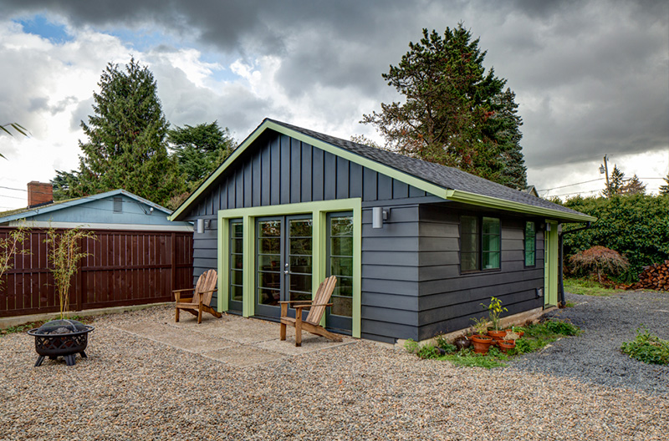
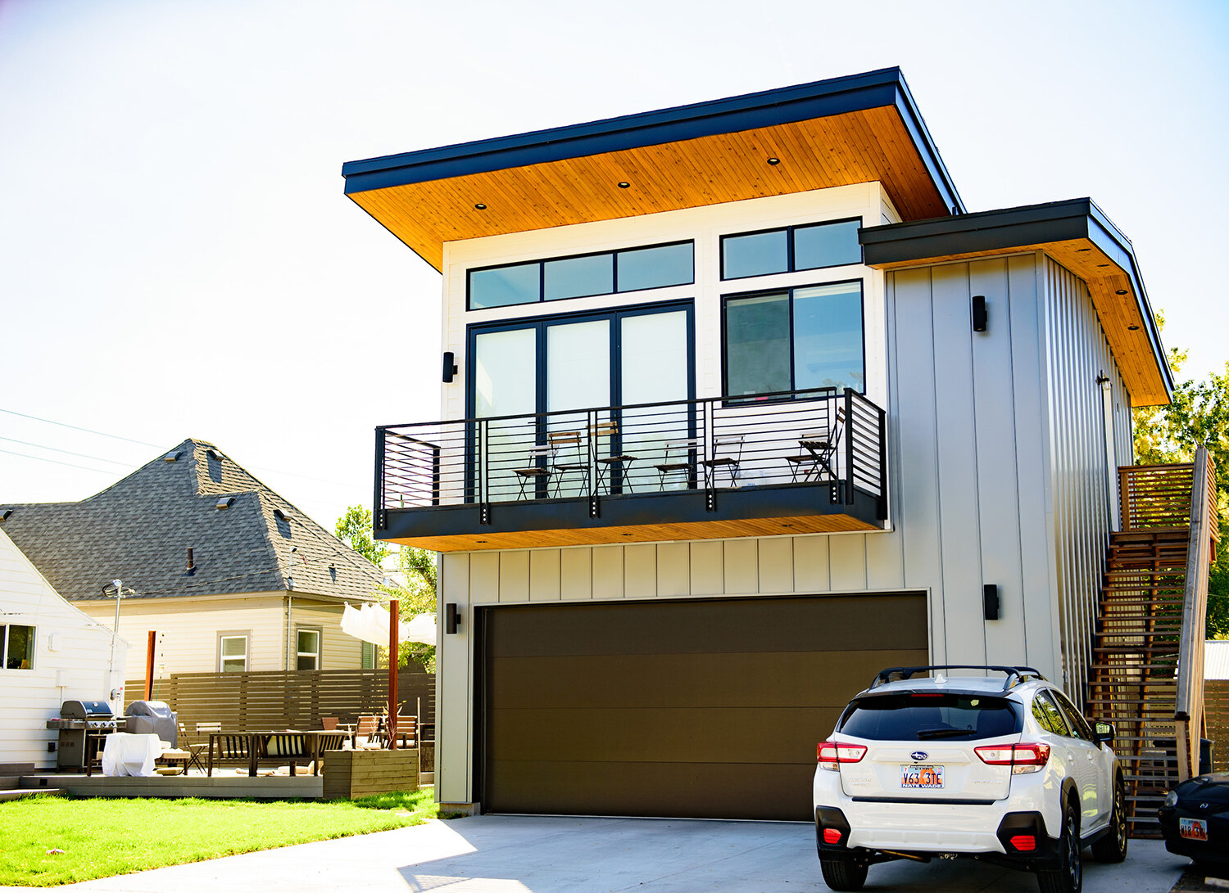
Z2 – 2021 & OPA 38 – 2021 (Additional Residential Units)
Examples of Additional Residential Unit:

Slide 8
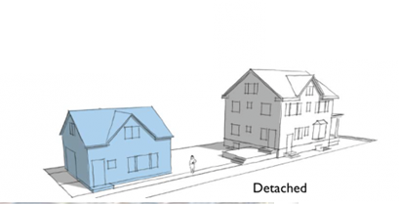
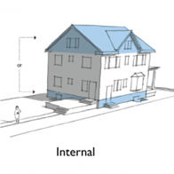
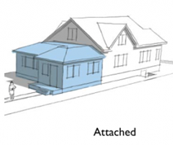
Z2 – 2021 & OPA 38 – 2021 (Additional Residential Units)
Examples of Locations:
OR a combination of detached and internal/attached

Slide 9
Z2 – 2021 & OPA38 – 2021 (Additional Residential Units)
Second ARU
Primary Dwelling
Draft Official Plan Amendments:
Additional Residential Unit(s), also known as accessory or basement apartments, secondary suites or in-law suites are self-enclosed residential units with separate kitchen, bathroom and sleeping accommodations. These units are subordinate in size and function to the principal building on the property.
Polices that apply to Additional Residential Units:
The use of two residential units in a single detached dwelling, semi-detached dwelling or rowhouse
The use of a residential unit in a building or structure accessory to a single-detached dwelling, semi-detached dwelling or rowhouse
An Additional Residential Unit will not be permitted within hazardous lands as defined and regulated by the Local Conservation Authority (NVCA)
An Additional Residential Unit will be required to be serviced by appropriate water and wastewater/stormwater services in a manner that is acceptable to the Township
Additional units may not be permitted on lands that are Environmentally Protected, wetlands, or flood prone
Additionally, surplus farm dwelling severance polices shall not be used to create separate lot for Additional Residential Units

Slide 10
Z2 – 2021 & OPA38 – 2021 (Additional Residential Units)
Second ARU
Primary Dwelling
Draft Official Plan Polices : The following criteria will be used as the basis for permitting Additional Residential Units
That safe road access can be provided;
The establishment of an Additional Residential Unit does not require the construction of an additional driveway access;
Additional Residential Unit will be regulated by the provisions of the Implementing Zoning By-law;
That any exterior alterations to the main residence, necessary to accommodate the Additional Residential Unit, are minimized to reduce visual impacts on the streetscape;
That the character of the primary residence be maintained;
That sufficient amenity areas are offered for the Primary Dwelling and Additional Residential Unit;
The Additional Residential Unit meets the applicable Building Code, Fire Code and local property regulations;
That a garden suite and Additional Residential Unit(s) cannot be permitted on the same lot;
The Additional Residential Unit will be established in accordance with the Minimum Distance Separation Formulae;
That adequate off-street parking can be provided on site for both the main residence and Additional Residential Unit;
All applicable permits and or approvals are required to be obtained from the Conservation Authority and any other agencies; and
The Additional Residential Unit is not considered multi-residential use for the purposes of the Site Plan Control By-law

Slide 11
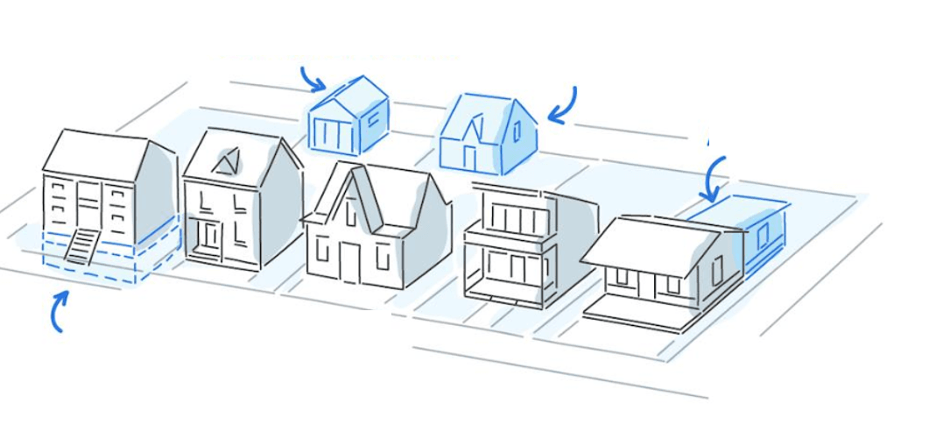
Z2 – 2021 & OPA38 – 2021 (Additional Residential Units)
Draft Official Plan Policies : The following criteria will be used as the basis for permitting Additional Residential Unit within an accessory building/structure
An Additional Residential Unit is prohibited from being severed from the property;
The Additional Residential Unit is situated within the principal building cluster on the property;
The establishment of an Additional Residential Unit does not require the construction of an additional driveway access;
The Additional Residential Unit will be evidently secondary to the main residence on the property; and
Minimum Distance Separation formula is complied with, where applicable. Local Municipalities may apply Site Plan Control to Additional Residential Units in accessory buildings or structures.

Slide 12
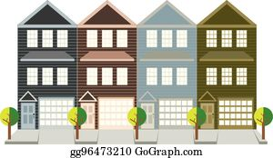
Z2 – 2021 & OPA38 – 2021 (Additional Residential Units)
Draft Zoning By-law Provisions Definitions
“Additional Residential Unit” shall mean a separate and self-contained dwelling unit that is subordinate to the Primary Dwelling and located within the same building or within a detached accessory building/structure on the same lot as the Primary Dwelling.
“Primary Dwelling” shall mean the main dwelling unit to which Additional Residential Units may be subordinate.
“Rowhouse” shall mean a consecutive series of similar residential units that shall share a maximum of two common walls with the adjacent units, situated on one lot.
Second ARU
Primary Dwelling

Slide 13
Z2 – 2021 & OPA38 – 2021 (Additional Residential Units)
Second ARU
Primary Dwelling
Draft Zoning By-law Provisions for all Units
Additional Residential Unit(s) shall be permitted on lands zoned to permit a single-detached dwelling, semi-detached dwelling, or rowhouse and/or located within a detached accessory building/structure on the same lot as the Primary Dwelling.
A maximum of two Additional Residential Units shall be permitted on a lot, one within the same building as the Primary Dwelling and one located in a detached accessory building/structure to the Primary Dwelling.
Additional Residential Unit(s) shall not be permitted on properties that are accessed from a private street.
In accordance with the Off-Street Parking Requirements provided within this by-law, a minimum of one (1) parking space per Additional Residential Unit is required to be provided and maintained on site for the sole use of the occupant of an Additional Residential Unit and may include tandem parking spaces.
Additional Residential Unit(s) shall be appropriately serviced and shall comply with all applicable health and safety standards.
The maximum floor area of an Additional Residential unit(s) shall be 50% of the gross floor area of the Primary Dwelling*
Additional Residential Unit(s) shall only be permitted if adequate connection to both municipal water supply and municipal sanitary sewers
Despite the above Additional Residential Unit(s) may be permitted where municipal water supply and municipal sanitary sewer are unavailable, if servicing can be demonstrated to the satisfaction of the Township

Slide 14
Z2 – 2021 & OPA38 – 2021 (Additional Residential Units)
Draft Zoning By-law Provisions
Additional Residential Unit(s) shall have separate sanitary and kitchen facilities from the Primary Dwelling.
Additional Residential Unit(s) shall not be permitted on a lot that is used for a Bed and Breakfast, Group Home, Private Home Tutor, Private Home Daycare, or Correctional use.
No Additional Residential Unit(s) shall be permitted within the flooding and erosion hazard limits of all watercourses.
Where any Primary Dwelling contains an Additional Residential Unit(s) and is permitted to have a home occupation, the home occupation shall be permitted in only 1 (one) of the units.
The civic address of a lot containing an Additional Residential Unit(s) shall clearly indicate the existence of an Additional Residential Unit(s) by adding signage.
A separate entrance shall be required for the Additional Residential Unit(s).

Slide 15
Z2 – 2021 & OPA38 – 2021 (Additional Residential Units)
Second ARU
Primary Dwelling
Draft Zoning By-law Provisions within a Primary Dwelling
Separate entrance required on rear or side of the Primary Dwelling, OR from an existing entrance
Draft Zoning By-law Provisions within an Accessory Building/Structure
The Additional Residential Unit within a detached accessory building/structure shall not exceed the maximum permitted accessory building/structure floor area for the applicable zone.
The maximum building height of an Additional Residential Unit contained within a detached accessory building/structure is two (2) storeys and shall not exceed the height of Primary Dwelling.
The applicable setbacks for the detached accessory building/structure within the applicable zone applies to an Additional Residential Unit on a residential use.
An Additional Residential Unit in a detached accessory building/structure may occupy a yard other than a front yard or required exterior side yard.
A minimum of 3 metres shall be provided between the Additional Residential Dwelling Unit in a detached accessory building/structure on the same Lot and any other structure permitted on the lot.
All other provisions of the respective zones are complied with.

Slide 16
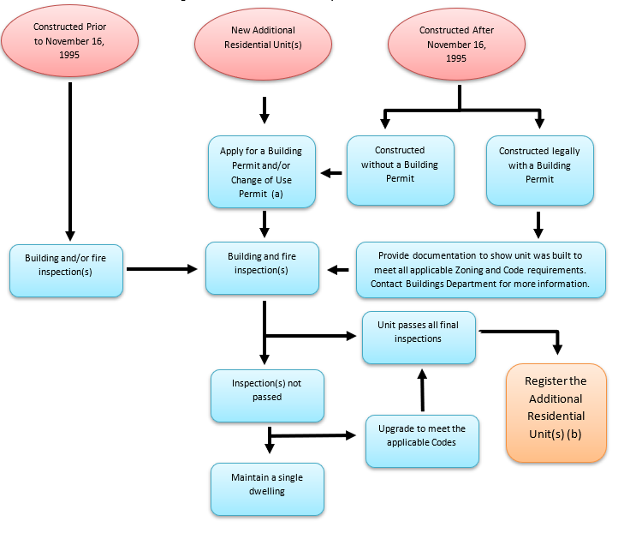
Z2 – 2021 & OPA38 – 2021 (Additional Residential Units)
Second ARU
Primary Dwelling
Registering your Additional Residential Units:
Make the unit legal through inspection, approval and registration
Registration Fee =$150.00
Re-inspection Fee=$75.00

Slide 17
Z2 – 2021 & OPA38 – 2021 (Additional Residential Units)
Second ARU
Primary Dwelling
Questions/Comments?
Next Steps…
Gather feedback on draft policies
Potential Policy revisions
Future Recommendation Report to Council by July 2021
County OPA Fall 2021
Zoning By-Law approval Fall 2021

